Slide 1
Laravel: Data Access
Course Code: CSC 4182
Course Title: Advanced Programming In Web Technologies
Dept. of Computer Science
Faculty of Science and Technology
Lecture No: | 15 | Week No: | 10 | Semester: | Summer 2020-2021
Lecturer: | MD.AL-AMIN; alamin@aiub.edu

Slide 2
Lecture Outline
Introduction to Eloquent ORM
Introduction to Query Builder
Configuring models for Eloquent
DB Configuration
SQL Operation using Query Builder
Performing Join query using query builder

Slide 3
Introduction to Eloquent ORM
ORM stands for Object Relational Mapping.
Eloquent is a powerful ORM used in Laravel framework.
Using eloquent is very easy and the syntaxes are easy to learn.
In eloquent for each database table has a corresponding "Model" which is used to interact with that table.
Models allow you to query for data in your tables, as well as insert new records into the table.
Operations like create, update, delete is very much easy with eloquent.
It has built in methods to run complex queries in a simple way.
Example:
$users = User::all();
User model which interacts with users table
Eloquent method to get all info of users table

Slide 4
Introduction to Query Builder
Laravel's database query builder provides a convenient, fluent interface to creating and running database queries.
It can be used to perform most database operations in your application and works on all supported database systems.
The Laravel query builder uses PDO parameter binding to protect your application against SQL injection attacks.
Example:
$users = DB::table('users')->get();
DB façade to begin query
returns a fluent query builder instance for the given table

Slide 5
Configuring models for Eloquent
To use eloquent we need to follow some rules while building models.
Models typically live in the app directory, but you are free to place them anywhere. (need some change in composer.json)
All Eloquent models extend Illuminate\Database\Eloquent\Model class.
Simply the model names should be singular and the table names should be plural.
Eloquent automatically maps with model and table.
You may specify a custom table by defining a table property on your model.
class Flight extends Model {
protected $table = 'my_flights';
}
Model | Table
User | users
Student | students
Course | courses

Slide 6
Configuring models for Eloquent
Eloquent will also assume that each table has a primary key column named id.
You may define a protected $primaryKey property to override this convention.
class Flight extends Model
{
protected $primaryKey = 'flight_id’;
}
Eloquent assumes that the primary key is an incrementing integer value, which means that by default the primary key will automatically be cast to an int. If you wish to use a non-incrementing or a non-numeric primary key you must set the public $incrementing property on your model to false.
class Flight extends Model
{
public $incrementing = false;
}
If your primary key is not an integer, you should set the protected $keyType property on your model to string
class Flight extends Model
{
protected $keyType = 'string';
}

Slide 7
Configuring models for Eloquent
By default, Eloquent expects created_at and updated_at columns to exist on your tables. If you do not wish to have these columns automatically managed by Eloquent, set the $timestamps property on your model to false
class Flight extends Model
{
public $timestamps = false;
}
If you need to customize the names of the columns used to store the timestamps, you may set the CREATED_AT and UPDATED_AT constants in your model.
class Flight extends Model
{
const CREATED_AT = 'creation_date';
const UPDATED_AT = 'last_update';
}
Other columns will automatically mapped with model properties.

Slide 8
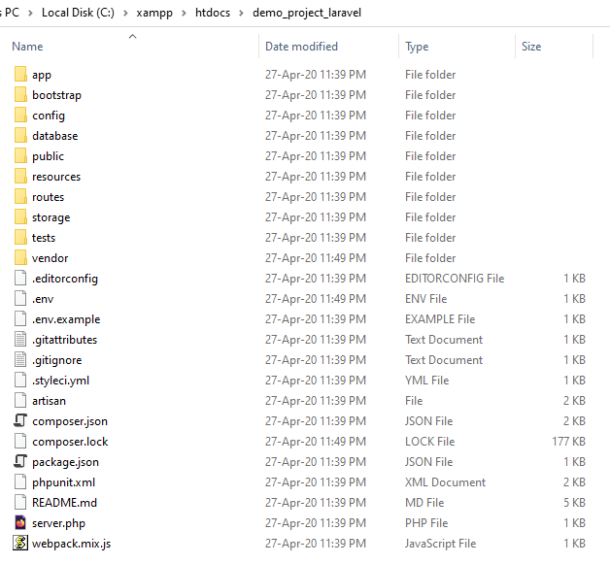
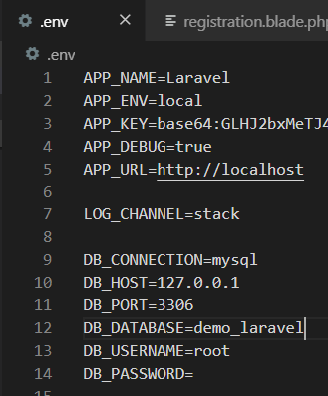
DB Configuration
Connecting with Database
Open xampp start mysql.
Create a database using phpMyAdmin
In project root directory open .env file
Update these values with yours

Slide 9
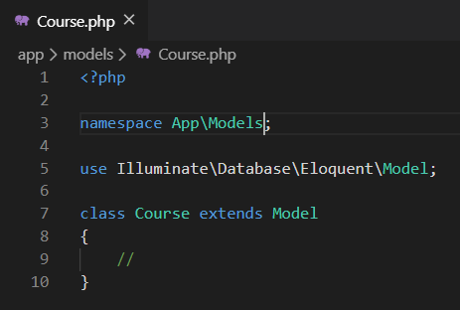
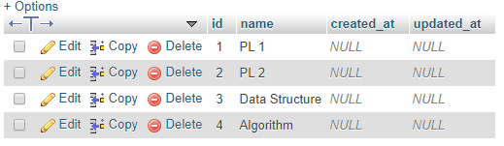
Creating Models
Model file resides in App directory.
Here I am creating a new folder named Models inside App and creating models.
Create a controller named CourseController
Create a view for showing all courses.
Create a function in CourseController.
Create a route and bind with controller method.
From the function we will retrieve data from database
Namespace should be App\Foldername
Must extend model class
courses table with values

Slide 10
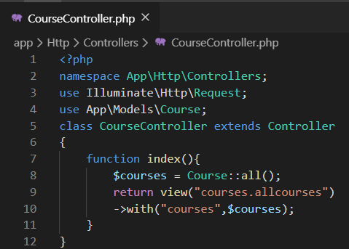
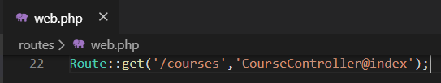
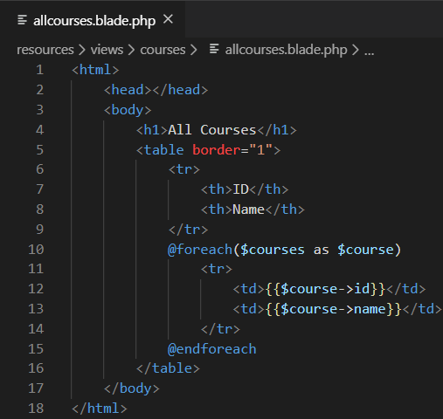
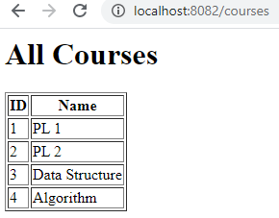
Retrieving Values
Route
Including our model
Eloquent all() method retrieves all information of courses table and returns an array of Courses
allcourses.blade.php is residing in resources/views/courses folder that’s why courses.allcourses
In view use as object.
See the properties id, name we did not declared in model but we can use it because those are database columns
Output

Slide 11
CRUD Operations
Insert Operation
Already we know how to submit form data. After submission data to controller
function insert_course(Request $request){
$course = new Course();
$course->name= $request->name;
$course->save();
return view('courses.allcourses');
}
Update Operation
function update_course(Request $request){
$course = Course::where('id' , $request->course_id)->first();
$course->name= $request->name;
$course->save();
return view('courses.allcourses');
}
Delete operation
function delete_course(Request $request){
$course = Course::where('id' , $request->course_id)->first();
$course->delete();
return view('courses.allcourses');
}

Slide 12
SQL Operation using Query Builder
Retrieving Data
Retrieving All Rows From A Table
$users = DB::table('users')->get();
Retrieving A Single Row From A Table
$user = DB::table('users')->where('name', 'John')->first();
Retrieving A Single Column From A Row
$name = DB::table('users')->where('name', 'John')->pluck('name');
Retrieving A List Of Column Values
$roles = DB::table('roles')->lists('title', 'name');
Specifying A Select Clause
$users = DB::table('users')->select('name', 'email')->get();

Slide 13
CRUD Operations
Insert Operation
Already we know how to submit form data. After submission data to controller
function insert_course(Request $request){
DB::table('courses')->insert( ['name' => $request->name]);
return view('courses.allcourses');
}
Update Operation
function update_course(Request $request){
DB::table('courses')
->where('id', $request->id)
->update(['name' => $request->name]);
return view('courses.allcourses');
}
Delete operation
function delete_course(Request $request){
DB::table('courses')
->where('id', $request->id)
->delete();
return view('courses.allcourses');
}
Delete all records
DB::table('courses')->delete();
Truncating A Table
DB::table('courses')->truncate();

Slide 14
Performing Join query
Basic Join Statement
DB::table('users')
->join('contacts', 'users.id', '=', 'contacts.user_id')
->join('orders', 'users.id', '=', 'orders.user_id')
->select('users.id', 'contacts.phone', 'orders.price')
->get();
Left Join Statement
DB::table('users')
->leftJoin('posts', 'users.id', '=', 'posts.user_id')
->get();

Slide 15
Books
PHP Advanced and Object-Oriented Programming, 3rd Edition; Larry Ullman; Peachpit, Press, 2013
PHP Objects, Patterns and Practice, 5th Edition; Matt Zandstra; Apress, 2016
Learning PHP, MySQL, JavaScript and CSS, 2nd Edition; Robin Nixon; O’Reilly, 2009
Eloquent JavaScript: A Modern Introduction to Programming; Marijn Haverbeke; 2011
Learning Node.js: A Hands On Guide to Building Web Applications in JavaScript; Marc Wandschneider; Addison-Wesley, 2013
Beginning Node.js; Basarat Ali Syed; Apress, 2014

Slide 16
References
https://laravel.com/docs/7.x/queries
https://laravel.com/docs/7.x/eloquent
https://laravel.com/docs/7.x/eloquent#eloquent-model-conventions

Slide 17
Thank You!

